Slide 1
Andean Spanish
based on: Lipski, John «El español de América», Madrid: Cátedra, 1994

Slide 2
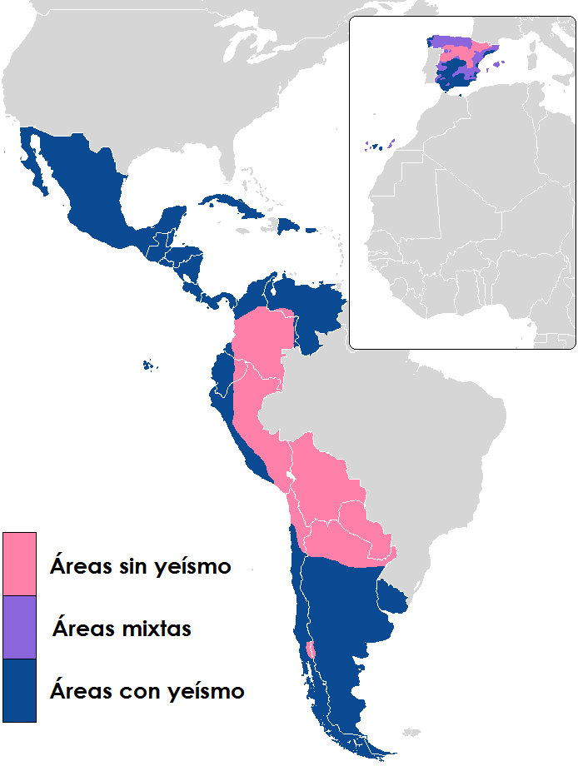
Approximate distribution of Andean Spanish (black circle line)

Slide 3
The most evident difference in syntax
Standard Spanish word order
Andean Spanish word order
S V O
S O V
O S V

Slide 4
Samples of differences in the word order
Andean Spanish
Standard Spanish
Me había dormido sin cerrar la puerta
I had fallen asleep without closing the door
I had fallen asleep without closing the door
Ya estábamos en Ayacucho
Already (we) were-1°pers.plur. in Ayacucho
We were already in Ayacucho
1. La puerta sin cerrar nomás me había dormido
The door without closing anymore I had fallen asleep
I had fallen asleep without closing the door
2. En Ayacucho ya estábamos
In Ayacucho already (we) were-1°pers.plur.
We were already in Ayacucho

Slide 5
Sample of the difference in the time agreement between main verb and secundary verb
Andean Spanish
Standard Spanish
Él quería que lo hag-amos
He wanted that it (we) do(subjun.pres.)-1°pers.plur.
He wanted us to do it (lit. he wanted that we do it)
El quería que lo hici-eramos
He wanted that it (we) do(subjun.past.)-1°pers.plur.
He wanted us to do it (lit. he wanted that we did it)

Slide 6
Samples of morpho-syntactic differences: redundancy («lo», «la» + Object)
1. No lo encuentro a su hijo
Not him (I) meet-Ipers.sing. accusat. prepos. her/his son
I cannot meet her/his son
2. ¿La ves una señora?
Her (do you) see-2° pers.sing. a woman
Can you see a woman?
3. Esto es el perro que lo mordió a mi hermano
This is the dog that him bit accusat.prepos. my brother
This is the dog that bit my brother
No encuentro a su hijo
Not (I) meet-Ipers.sing. accusat. prepos. her/his son
I cannot meet her/his son
¿Ves una señora?
(Do you) see-2° pers.sing. a woman
Can you see a woman?
Esto es el perro que mordió a mi hermano
This is the dog that bit accusat.prepos. my brother
This is the dog that bit my brother

Slide 7
Some well-known words used by Andean Spanish speakers
anticuchos
cancha
chacra
chompa
jora (/x/ora, as in Lochness)
pisco
skewers
roasted maize
cultivated field
pullover
brewed maize, used for home made maize beer (chicha)
grape brandy

Slide 8
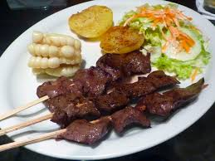
anticuchos

Slide 9
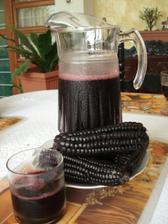
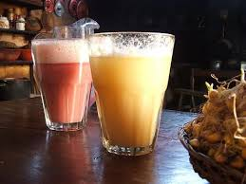
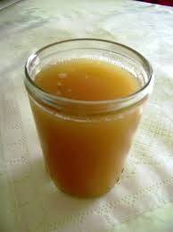
jora

Slide 10
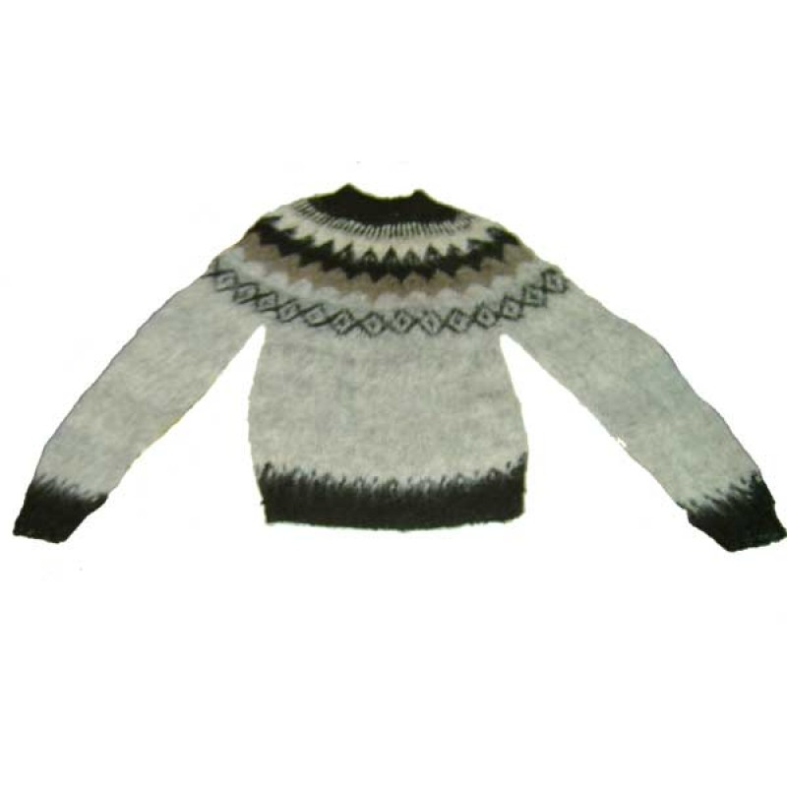
chompa

